Slide 1
CIS 4517/5517: Data Intensive and Cloud Computing MapReduce examples
Dr. Xubin He
Computer and Information Sciences
Temple University

Slide 2
Credit:
Most slides are adapted from: http://www.mmds.org
Mining of Massive Datasets, by Jure Leskovec, Anand Rajaraman, Jeff Ullman
Read Chapter 2 of “Mining of Massive Datasets” at http://www.mmds.org

Slide 3
Motivation: Google Example
20+ billion web pages x 20KB = 400+ TB
1 computer reads 30-35 MB/sec from disk
~4 months to read the web
~1,000 hard drives to store the web
Takes even more to do something useful with the data!
Today, a standard architecture for such problems is emerging:
Cluster of commodity Linux nodes
Commodity network (ethernet) to connect them

Slide 4
Cluster Architecture
2-10 Gbps backbone between racks
1 Gbps between
any pair of nodes
in a rack
Switch
Switch
Switch
CPU
CPU
CPU
CPU
Mem
…
Mem
Mem
…
Mem
Disk
Disk
Disk
Disk
Each rack contains 16-64 nodes
In 2011 it was estimated that Google had 1M machines, http://bit.ly/Shh0RO

Slide 5
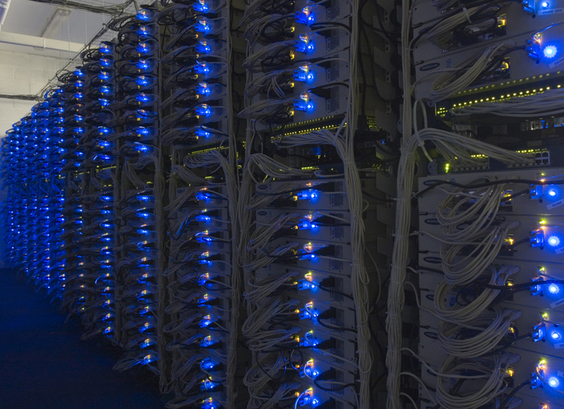

Slide 6
Large-scale Computing
Large-scale computing for data mining problems on commodity hardware
Challenges:
How do you distribute computation?
How can we make it easy to write distributed programs?
Machines fail:
One server may stay up 3 years (1,000 days)
If you have 1,000 servers, expect to loose 1/day
People estimated Google had ~1M machines in 2011
1,000 machines fail every day!

Slide 7
Idea and Solution
Issue: Copying data over a network takes time
Idea:
Bring computation close to the data
Store files multiple times for reliability
Map-reduce addresses these problems
Google’s computational/data manipulation model
Elegant way to work with big data
Storage Infrastructure – File system
Google: GFS. Hadoop: HDFS
Programming model
Map-Reduce

Slide 8
Storage Infrastructure
Problem:
If nodes fail, how to store data persistently?
Answer:
Distributed File System:
Provides global file namespace
Google GFS; Hadoop HDFS;
Typical usage pattern
Huge files (100s of GB to TB)
Data is rarely updated in place
Reads and appends are common

Slide 9
Distributed File System
Reliable distributed file system
Data kept in “chunks”/blocks spread across machines
Each chunk or block replicated on different machines
Seamless recovery from disk or machine failure
C₀
C₁
D₀
C₁
C₂
C₅
C₀
C₅
…
C₅
Chunk server 1
C₂
C₅
Chunk server 2
C₃
D₀
Chunk server 3
D₁
D₀
Chunk server N
C₂
Bring computation directly to the data!
Chunk servers also serve as compute servers
Notes:
9

Slide 10
MapReduce
We are devoted to large scale computing for data mining
Challenges:
How to distribute computation?
Distributed/parallel programming is hard
Map-reduce addresses both of the above
Google’s computational/data manipulation model
Elegant way to work with big data

Slide 11
MapReduce: The Map Step
Input
key-value pairs
Intermediate
key-value pairs
k
v
map
k
v
k
v
map
k
v
k
v
…
…
k
v
k
v

Slide 12
MapReduce: The Reduce Step
Output
key-value pairs
Intermediate
key-value pairs
Key-value groups
reduce
k
v
k
v
v
v
k
v
Group
by key
reduce
k
v
k
v
v
k
v
k
v
…
…
…
k
v
k
v
k
v

Slide 13
More Specifically
Input: a set of key-value pairs
Programmer specifies two methods:
Map(k, v) → <k’, v’>*
Takes a key-value pair and outputs a set of key-value pairs
E.g., key is the filename, value is a single line in the file
There is one Map call for every (k,v) pair
Reduce(k’, <v’>*) → <k’, v’’>*
All values v’ with same key k’ are reduced together and processed in v’ order
There is one Reduce function call per unique key k’

Slide 14
MapReduce: Word Counting
Provided by the programmer
Provided by the programmer
MAP:
Read input and produces a set of key-value pairs
Group by key:
Collect all pairs with same key
Reduce:
Collect all values belonging to the key and output
The crew of the space shuttle Endeavor recently returned to Earth as ambassadors, harbingers of a new era of space exploration. Scientists at NASA are saying that the recent assembly of the Dextre bot is the first step in a long-term space-based man/mache partnership. '"The work we're doing now -- the robotics we're doing -- is what we're going to need ……………………..
(The, 1)
(crew, 1)
(of, 1)
(the, 1)
(space, 1)
(shuttle, 1)
(Endeavor, 1)
(recently, 1)
….
(crew, 1)
(crew, 1)
(space, 1)
(the, 1)
(the, 1)
(the, 1)
(shuttle, 1)
(recently, 1)
…
(crew, 2)
(space, 1)
(the, 3)
(shuttle, 1)
(recently, 1)
…
Sequentially read the data
Only sequential reads
Big document
(key, value)
(key, value)
(key, value)

Slide 15
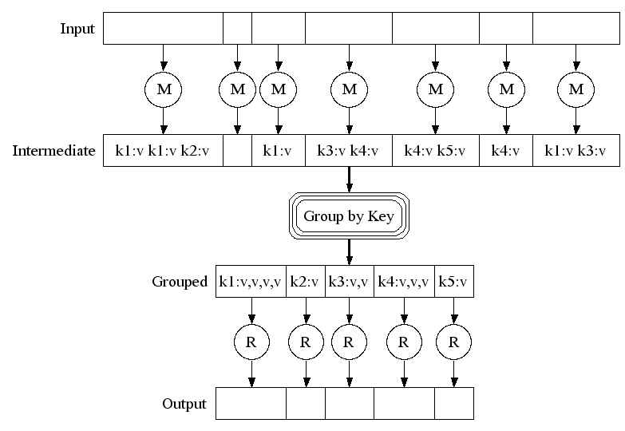
Map-Reduce: A diagram
Big document
MAP:
Read input and produces a set of key-value pairs
Group by key:
Collect all pairs with same key
(Hash merge, Shuffle, Sort, Partition)
Reduce:
Collect all values belonging to the key and output

Slide 16
Problems Suited for Map-Reduce

Slide 17
Examples
Counting tasks
Find the total size in bytes of a host
Compute the frequency of all k-grams on the web
Compute the frequency of queries
Compute the frequency of query, url pairs
Other examples:
Link analysis and graph processing – PageRank
Machine Learning algorithms
Linear algebra operations (matrix-vector, matrix-matrix multiplication)

Slide 18
Example: Host size
Suppose we have a large web corpus
Look at the metadata file
Lines of the form: (URL, size, date, …)
For each host, find the total number of bytes
That is, the sum of the page sizes for all URLs from that particular host
Other examples:
Link analysis and graph processing
Machine Learning algorithms

Slide 19
Example: Language Model
Statistical machine translation:
Need to count number of times every 5-word sequence occurs in a large corpus of documents
Very easy with MapReduce:
Map:
Extract (5-word sequence, count) from document
Reduce:
Combine the counts

Slide 20
Example: Join By Map-Reduce
Compute the natural join R(A,B) ⋈ S(B,C)
R and S are each stored in files
Tuples are pairs (a,b) or (b,c)
A | B
a₁ | b₁
a₂ | b₁
a₃ | b₂
a₄ | b₃
B | C
b₂ | c₁
b₂ | c₂
b₃ | c₃
A | C
a₃ | c₁
a₃ | c₂
a₄ | c₃
⋈
=
S
R

Slide 21
Map-Reduce Join
A Map process turns:
Each input tuple R(a,b) into key-value pair (b,(a,R))
Each input tuple S(b,c) into (b,(c,S))
Map processes send each key-value pair with key b to Reduce process
Hadoop does this automatically; just tell it what k is.
Each Reduce process matches all the pairs (b,(a,R)) with all (b,(c,S)) and outputs (a,b,c).

Slide 22
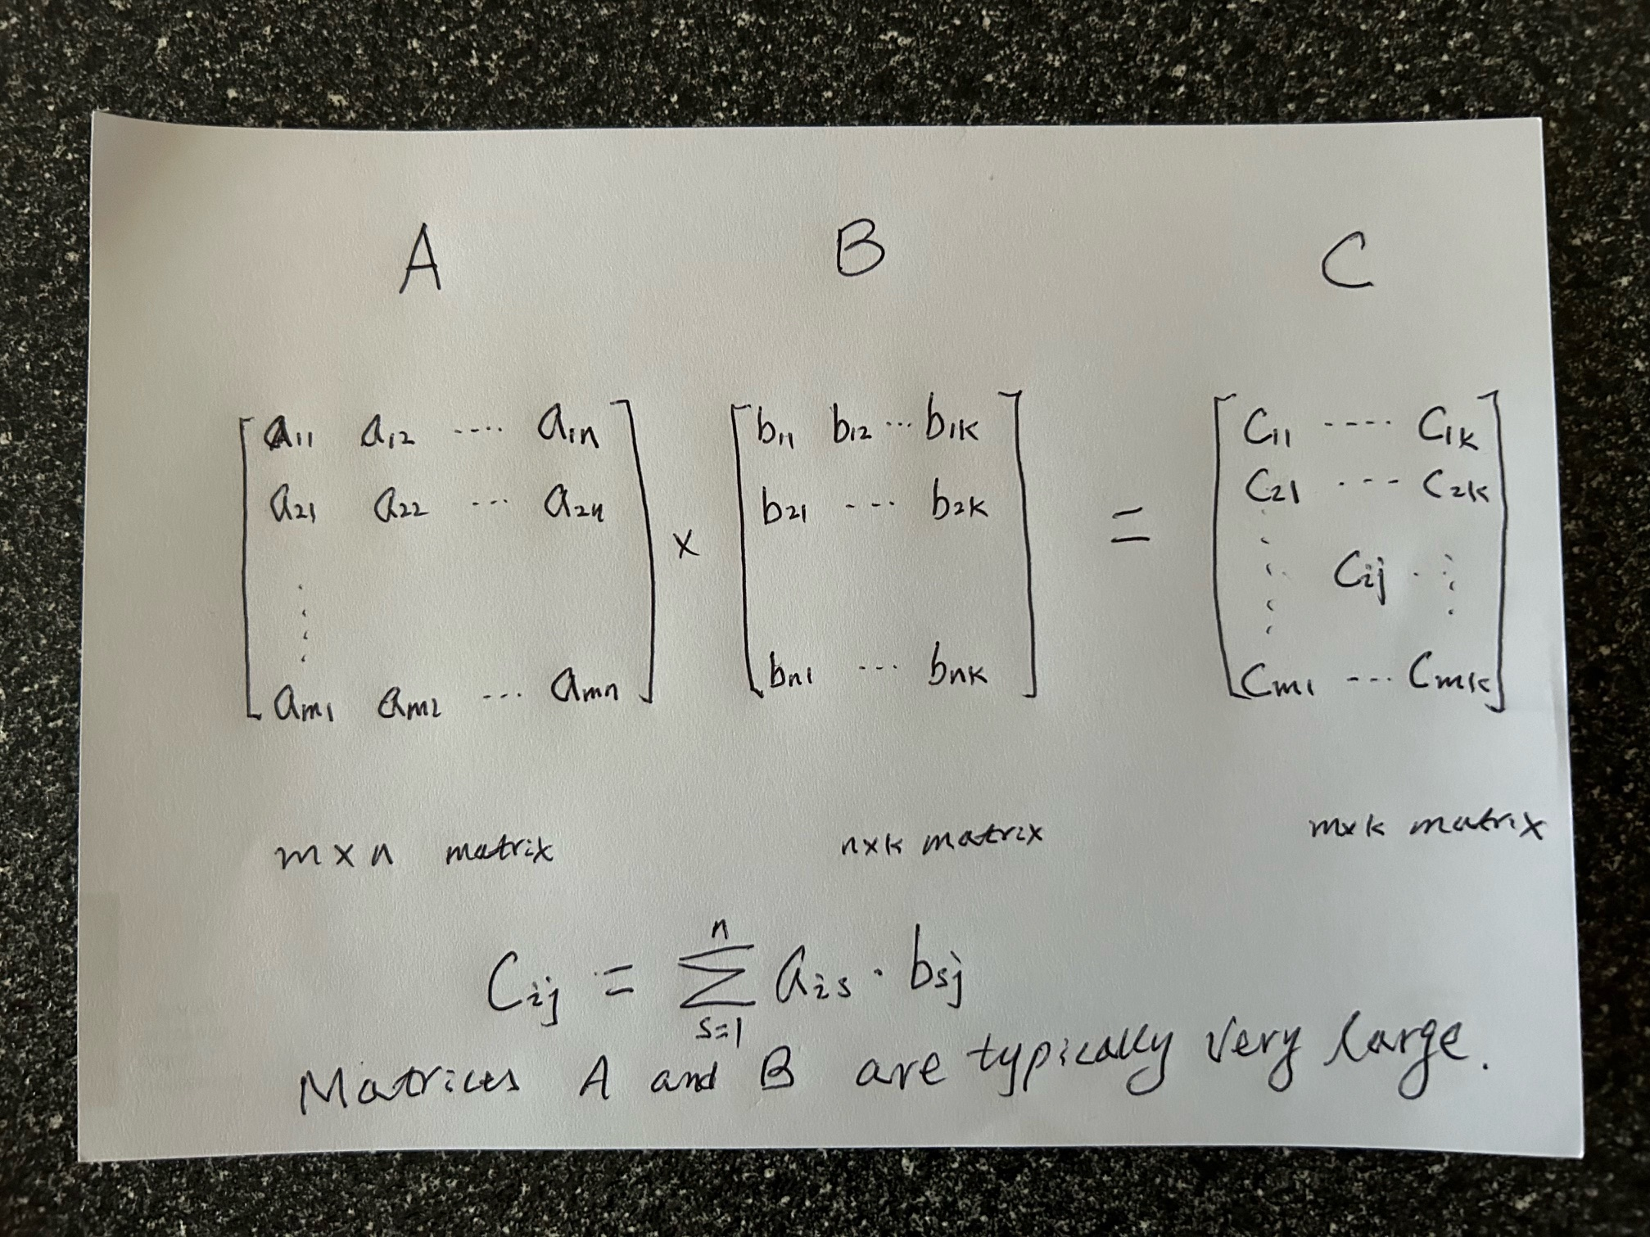
Matrix multiplication

Slide 23


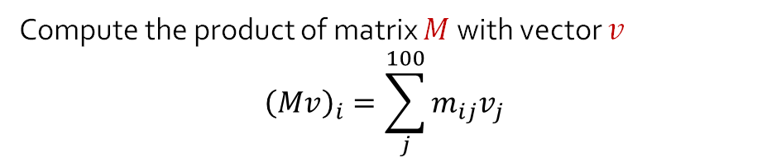
Matrix multiplication
Matrix – Vector Multiplication
and
Matrix – Matrix Multiplication
Compute the product of matrix $M$with vector $v$
$${\left(Mv\right)}_{i}=\sum_{j}^{100}{m_{ij}v_{j}}$$
30,000,000,000,000

Slide 24
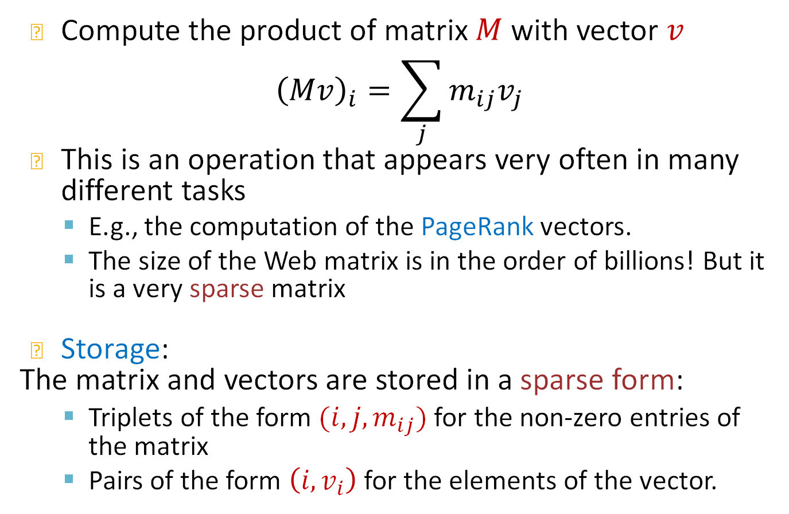
Matrix-Vector multiplication
Compute the product of matrix $M$with vector $v$
$${\left(Mv\right)}_{i}=\sum_{j}{m_{ij}v_{j}}$$
This is an operation that appears very often in many different tasks
E.g., the computation of the PageRank vectors.
The size of the Web matrix is in the order of billions! But it is a very sparse matrix
Storage:
The matrix and vectors are stored in a sparse form:
Triplets of the form $(i,j,m_{ij})$ for the non-zero entries of the matrix
Pairs of the form $\left(i, v_{i}\right)$ for the elements of the vector.

Slide 25
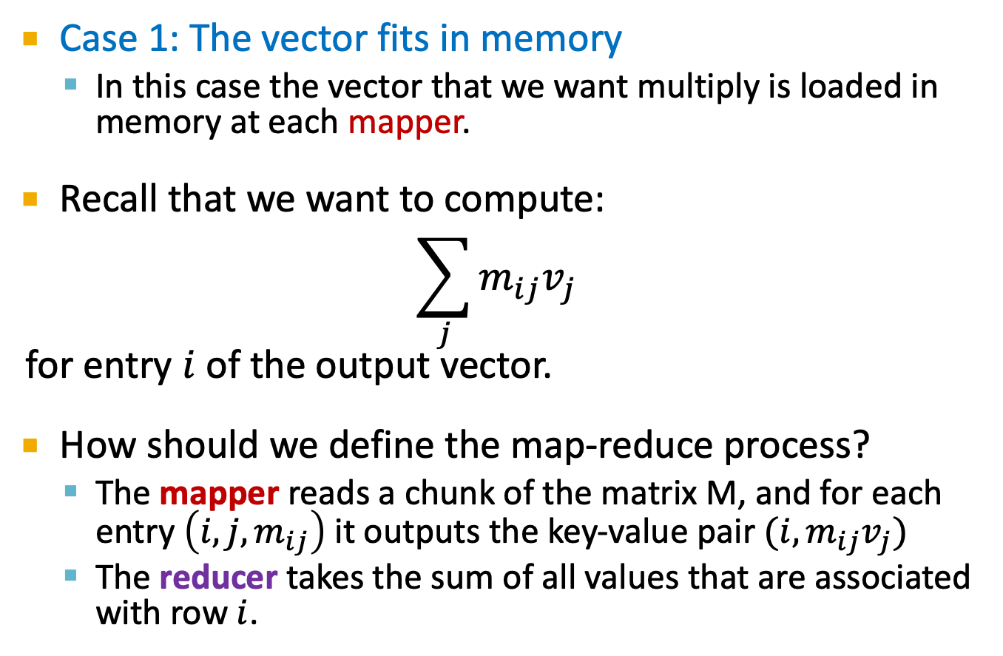
Matrix-vector multiplication
Case 1: The vector fits in memory
In this case the vector that we want multiply is loaded in memory at each mapper.
Recall that we want to compute:
$$\sum_{j}{m_{ij}v_{j}}$$
for entry $i$ of the output vector.
How should we define the map-reduce process?
The mapper reads a chunk of the matrix M, and for each entry $\left(i,j,m_{ij}\right)$ it outputs the key-value pair $(i, m_{ij}v_{j})$
The reducer takes the sum of all values that are associated with row $i$.

Slide 26
Matrix-vector multiplication
Case 2: The vector does not fit in memory
In this case we split the matrix and the vector into stripes:
We perform the computation for each stripe of the matrix, where the vector can fit into memory
For PageRank it is better to split the matrix into blocks.

Slide 27
Example: Sparse Matrices with Map/Reduce
A
B
C
10
20
-1
-10
-80
30
40
X
-2
-3
=
-60
-250
50
60
70
-4
-170
-460
Task: Compute product C = A·B
Assume most matrix entries are 0
Motivation
Core problem in scientific computing
Challenging for parallel execution
Demonstrate expressiveness of Map/Reduce

Slide 28
Computing Sparse Matrix Product
A
B
1
10
1
1
-1
1
10
20
A
-1
B
1
20
3
2
-2
1
30
40
A
-2
-3
B
2
30
2
2
-3
2
50
60
70
A
-4
B
2
40
3
3
-4
2
A
B
3
50
1
A
3
60
2
A
3
70
3
A
Represent matrix as list of nonzero entries
⟨row, col, value, matrixID⟩
Strategy
Phase 1: Compute all products a_{i,k} · b_{k,j}
Phase 2: Sum products for each entry i,j
Each phase involves a Map/Reduce

Slide 29
Phase 1 Map of Matrix Multiply
1
10
1
Key = 1
A
10
1
20
3
1
A
1
A
1
-1
1
30
50
B
2
2
3
A
1
A
2
40
3
Key = col
A
Key = 2
3
50
1
2
30
2
2
-2
1
A
A
B
3
60
2
60
2
-3
2
A
3
A
2
B
3
70
3
A
-1
Key = 3
1
B
1
1
20
3
-2
A
Key = row
2
B
1
40
3
-4
2
2
A
3
B
2
-3
2
B
70
-4
3
A
3
3
B
2
Group values a_{i,k} and b_{k,j} according to key k

Slide 30
Phase 1 “Reduce” of Matrix Multiply
Key = 1
1
-10
1
1
10
1
C
A
X
1
-1
1
-50
B
3
C
1
3
50
1
A
2
-60
1
Key = 2
C
2
30
2
2
-2
1
2
-90
2
A
X
B
C
60
2
-3
2
3
-120
1
3
A
2
B
C
3
-180
2
C
Key = 3
20
1
-80
2
1
A
3
C
-4
2
-160
2
2
40
3
X
3
B
2
C
A
-280
3
C
2
3
70
3
A
Generate all products a_{i,k} · b_{k,j}

Slide 31
Phase 2 Map of Matrix Multiply
-10
Key = 1,1
1
1
1
-10
1
C
C
3
-50
1
-80
Key = 1,2
C
1
C
2
Key = 2,1
2
-60
1
2
-60
1
C
C
2
-90
2
Key = row,col
Key = 2,2
C
2
-90
2
-120
C
3
C
1
2
-160
2
-180
C
3
C
2
Key = 3,1
3
-120
1
-80
C
1
C
2
3
-50
1
C
2
-160
2
C
Key = 3,2
3
-280
2
3
-280
2
C
C
-180
3
C
2
Group products a_{i,k} · b_{k,j} with matching values of i and j

Slide 32
Phase 2 Reduce of Matrix Multiply
Key = 1,1
1
-10
1
1
-10
1
C
C
-80
-80
Key = 1,2
1
C
2
1
C
2
Key = 2,1
2
-60
1
2
-60
1
C
C
C
Key = 2,2
-10
-80
2
-90
2
-250
C
2
C
2
-160
-60
-250
2
C
2
-170
-460
Key = 3,1
3
-120
1
3
-170
1
C
C
3
-50
1
C
Key = 3,2
3
-280
2
-460
C
3
C
2
3
-180
2
C
Sum products to get final entries

Slide 33
More on Matrix – Matrix Multiplication
http://www.mathcs.emory.edu/~cheung/Courses/554/Syllabus/9-parallel/matrix-mult.html
Machine Learning
https://www.youtube.com/watch?v=TCA2VuHTHcM
https://www.coursera.org/lecture/machine-learning/map-reduce-and-data-parallelism-10sqI

Slide 34
More examples of Map/Reduce
Host size
For each host, find the total number of bytes
Language model
Count the number of times every n-word sequence occurs in a large pile of documents
Graph reversal
Construct the graph in which all the links are reversed
and more…
Please check and work by yourself if interested.

Slide 35
Example: Host size
Suppose we have a large web corpus
Look at the metadata file
Lines of the form: (URL, size, date, …)
For each host, find the total number of bytes
That is, the sum of the page sizes for all URLs from that particular host

Slide 36
Chaining Multiple MapReduce
Count of URL access frequency
Input: Log of accessed URLs, e.g., from proxy server
Output: For each URL, % of total accesses for that URL
Map – Process web log and outputs <URL, 1>
Multiple Reducers - Emits <URL, URL_count>
(So far, like Wordcount. But still need %)
Chain another MapReduce job after above one
Map – Processes <URL, URL_count> and outputs <1, (<URL, URL_count> )>
1 Reducer – Sums up URL_count’s to calculate overall_count.
Emits multiple <URL, URL_count/overall_count>

Slide 37
Example: Language Model
Statistical machine translation:
Need to count number of times every 5-word sequence occurs in a large corpus of documents
Very easy with MapReduce:
Map:
Extract (5-word sequence, count) from document
Reduce:
Combine the counts

Slide 38
Example : Graph reversal
Given a directed graph as an adjacency list:
src1: dest11, dest12, …
src2: dest21, dest22, …
Construct the graph in which all the links are reversed
Can be done in two phases and each phase involves a map/reduce.

Slide 39
Phase 1 Mapper
public class P1Mapper extends MapReduceBase implements Mapper {
public void map(WritableComparable key, Writable values,
OutputCollector output, Reporter reporter) throws IOException {
try {
GraphEdge e = new GraphEdge(values.toString());
IntWritable k;
if (e.tag.equals("A"))
k = new IntWritable(e.toNode);
else
k = new IntWritable(e.fromNode);
output.collect(k, new Text(e.toString()));
} catch (BadGraphException e) {}
}
}

Slide 40
Phase 1 Reducer
public class P1Reducer extends MapReduceBase implements Reducer {
public void reduce(WritableComparable key, Iterator values,
OutputCollector output, Reporter reporter)
throws IOException
{
Text outv = new Text(""); // Don't really need output values
/* First split edges into A and B categories */
LinkedList<GraphEdge> alist = new LinkedList<GraphEdge>();
LinkedList<GraphEdge> blist = new LinkedList<GraphEdge>();
while(values.hasNext()) {
try {
GraphEdge e =
new GraphEdge(values.next().toString());
if (e.tag.equals("A")) {
alist.add(e);
} else {
blist.add(e);
}
} catch (BadGraphException e) {}
}
// Continued

Slide 41
MM Phase 1 Reducer (cont.)
// Continuation
Iterator<GraphEdge> aset = alist.iterator();
// For each incoming edge
while(aset.hasNext()) {
GraphEdge aedge = aset.next();
// For each outgoing edge
Iterator<GraphEdge> bset = blist.iterator();
while (bset.hasNext()) {
GraphEdge bedge = bset.next();
GraphEdge newe = aedge.contractProd(bedge);
// Null would indicate invalid contraction
if (newe != null) {
Text outk = new Text(newe.toString());
output.collect(outk, outv);
}
}
}
}
}

Slide 42
Phase 2 Mapper
public class P2Mapper extends MapReduceBase implements Mapper {
public void map(WritableComparable key, Writable values,
OutputCollector output, Reporter reporter)
throws IOException {
String es = values.toString();
try {
GraphEdge e = new GraphEdge(es);
// Key based on head & tail nodes
String ks = e.fromNode + " " + e.toNode;
output.collect(new Text(ks), new Text(e.toString()));
} catch (BadGraphException e) {}
}
}

Slide 43
Graph Phase 2 Reducer
public class P2Reducer extends MapReduceBase implements Reducer {
public void reduce(WritableComparable key, Iterator values,
OutputCollector output, Reporter reporter)
throws IOException
{
GraphEdge efinal = null;
while (efinal == null && values.hasNext()) {
try {
efinal = new GraphEdge(values.next().toString());
} catch (BadGraphException e) {}
}
if (efinal != null) {
while(values.hasNext()) {
try {
GraphEdge eother =
new GraphEdge(values.next().toString());
efinal.weight += eother.weight;
} catch (BadGraphException e) {}
}
if (efinal.weight != 0)
output.collect(new Text(efinal.toString()),
new Text(""));
}
}
}

Slide 44
Next
PageRank

